Slide 1
Cyclistic Marketing Strategy
2020
Cyclistic Bike-Share Analysis
Google Data Analytics Case Study
Dawid Sosinski
21/12/2021

Slide 2
Table of Content
New email marketing campaign
Annual member customer profile
Gender
Age
Trip duration
Day of the Week
Casual Customer Opportunity
Key Result
Next actions
Appendix

Slide 3
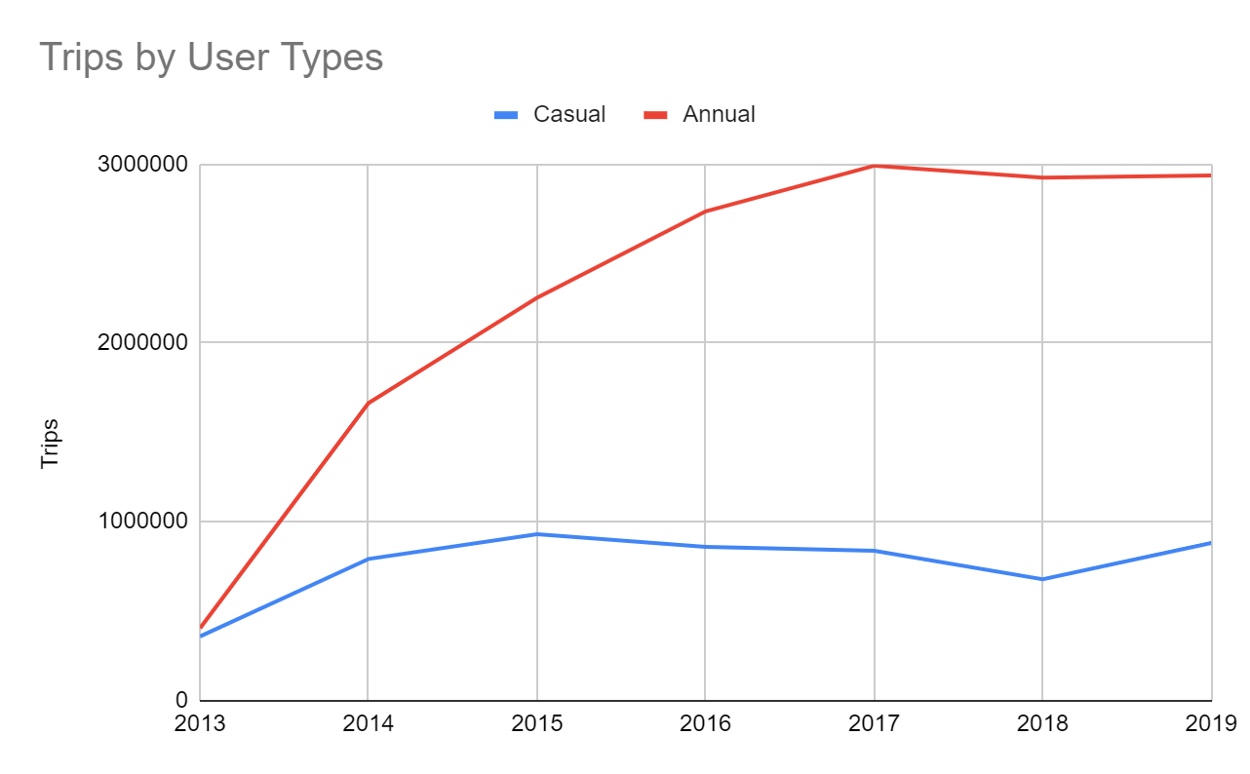
New marketing campaign
The future success of our company depends on maximizing the number of annual memberships
23% of all trips in 2019 where made by casual riders
Number of rides in 2019 by annual members increased only 0.39% vs 2018
In order to grow company profits we need to
convert casual riders into annual members
We need to understand how annual members
use our service

Slide 4
Annual member customer profile
We need to create an idea annual membership customer profile
The profile will identify our annual member’s gender, age, trip duration and time
Casual rider trip data will be checked for customer conversion opportunities

Slide 5
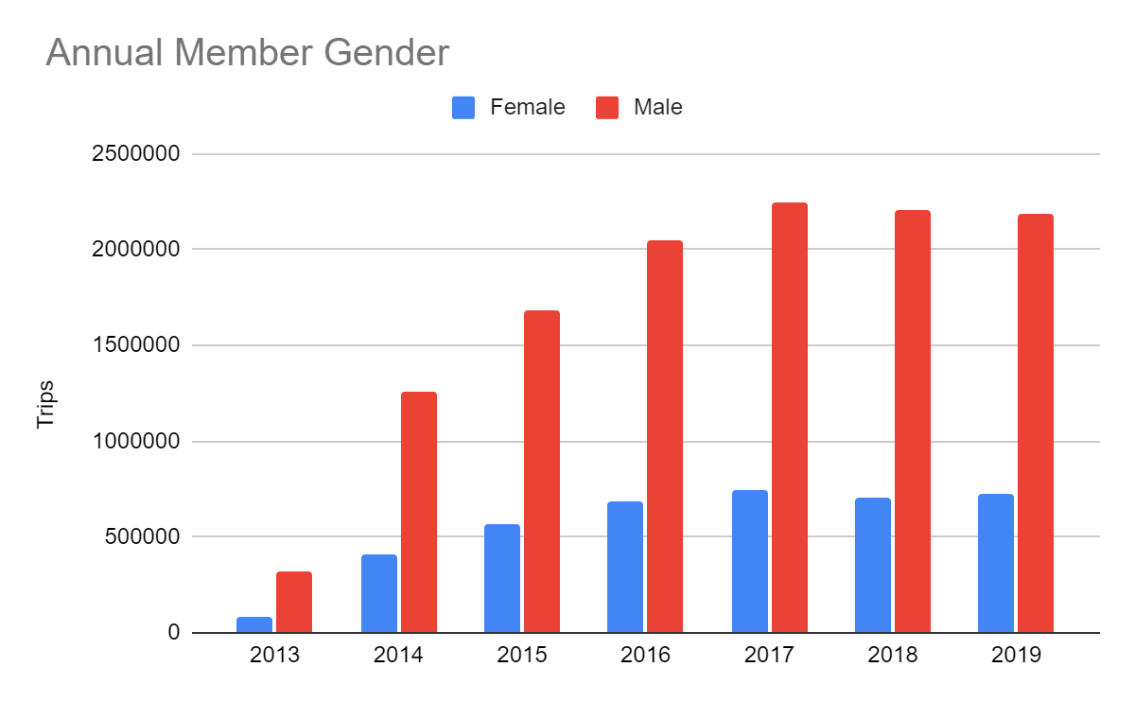
Annual Member Gender
Male riders made majority of trips every year
from 2013 until 2019
75% of all trips in 2019 were made by
male riders
Male riders are more likely to use our
annual membership product

Slide 6
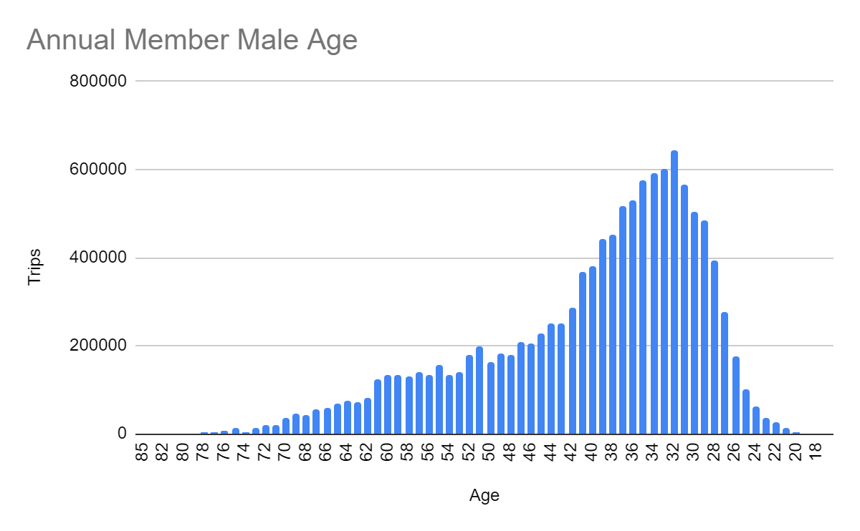
Annual Male Member Age
Male riders between age 26 and 40
made majority of all trips

Slide 7
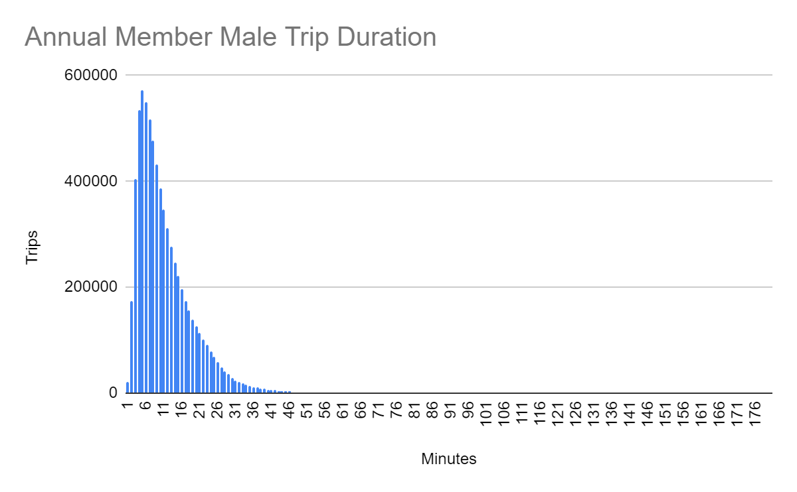
Annual Male Member Trip Duration
Majority of trips lasted between
1 and 16 minutes

Slide 8
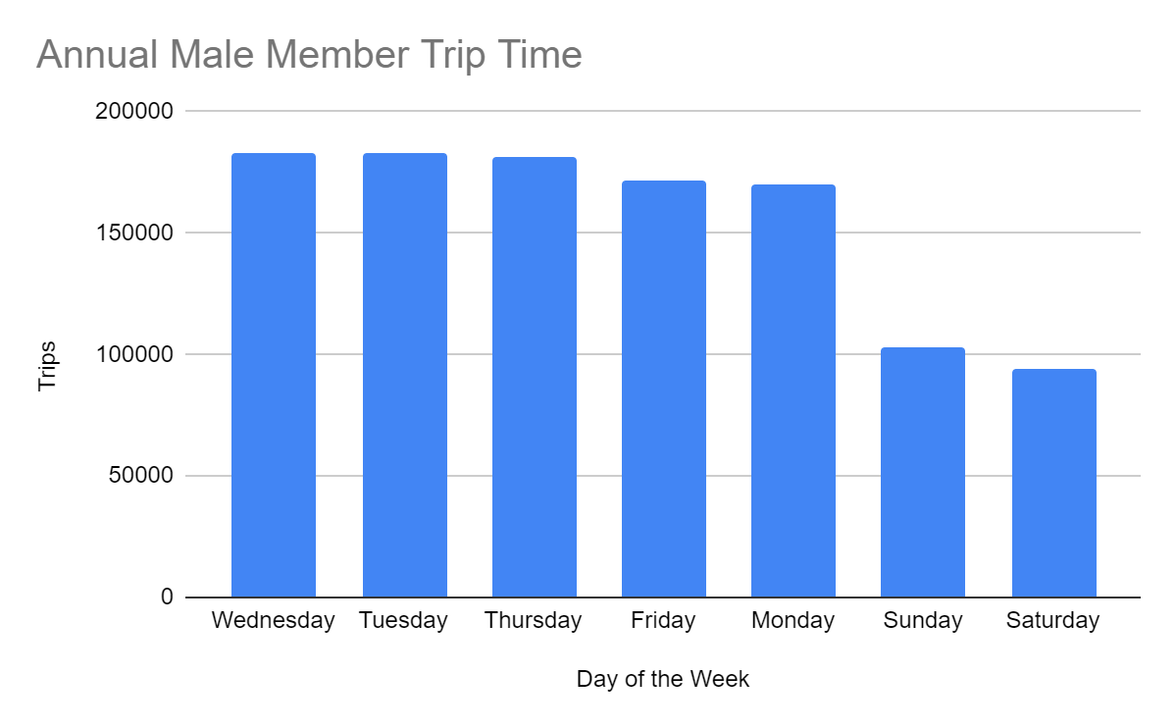
Annual Male Member Trip Time
Majority of trips on weekdays
from Monday until Friday

Slide 9
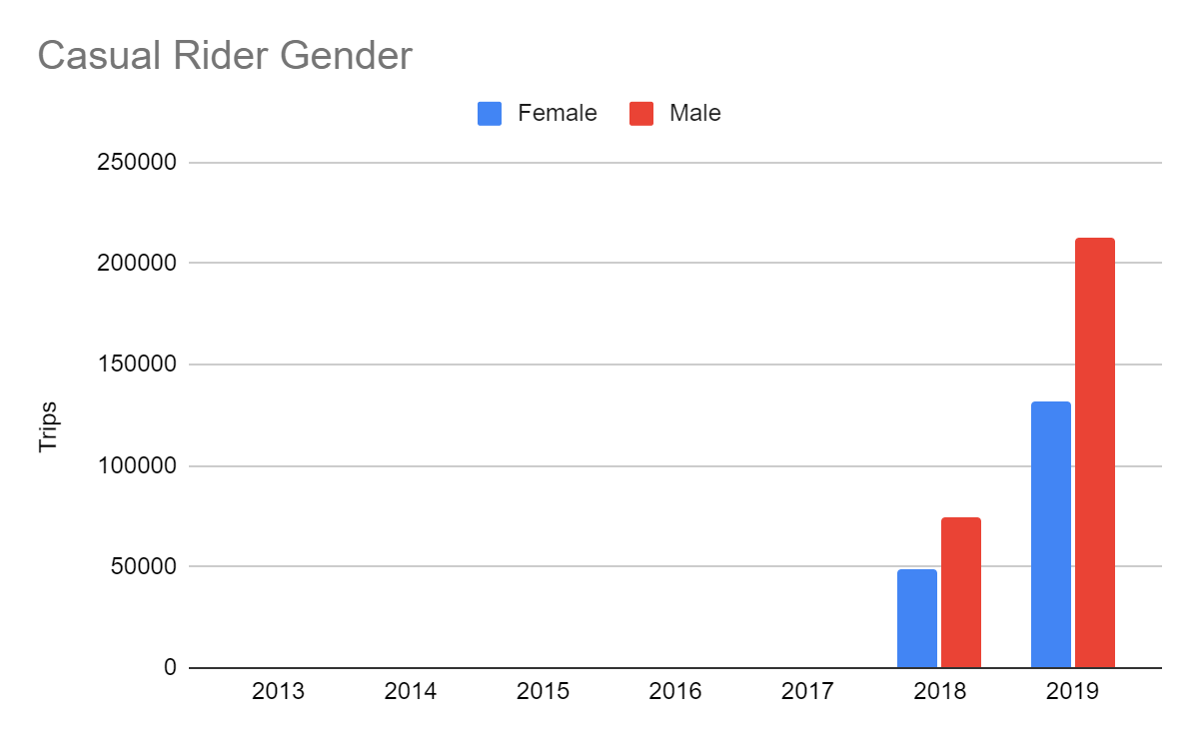
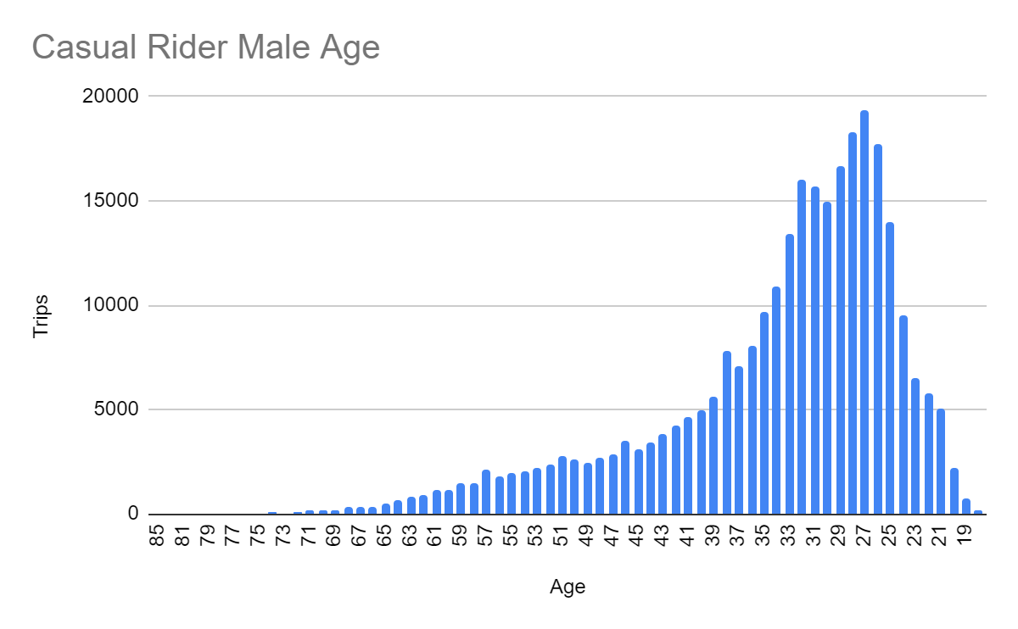
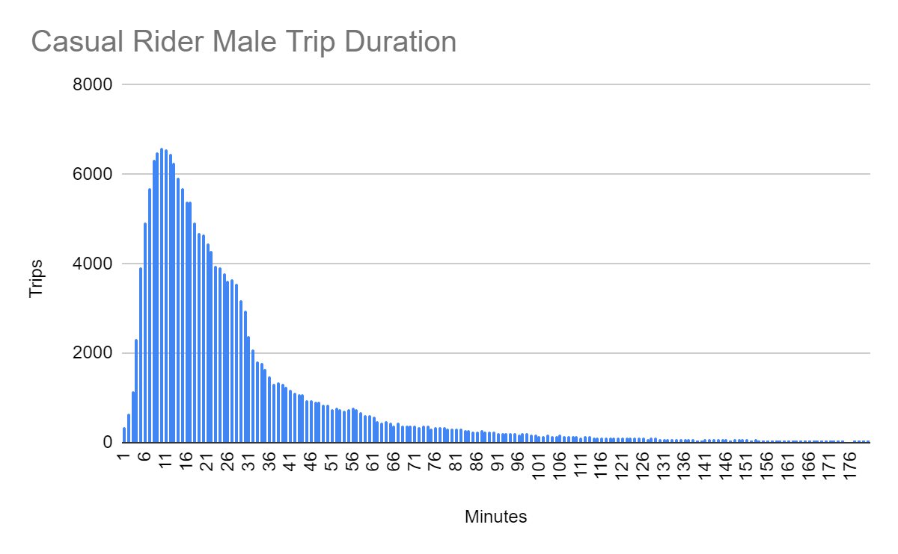
Casual Customer Opportunity
The annual membership customer profile
was created that consists of:
Male riders
Age between 26 and 40
Ride between 1 min and 16 mins
From Monday until Friday
The annual membership customer profile was compared with casual rider data
Casual rider data indicates that 3740 trips were made in 2019 (10.89%) with the same customer profile

Slide 10
Key Result
We need an objective and measurable indicator to test success of our marketing campaign
By creating new targeted campaign we can convert:
17% of male casual rider trips into annual membership ones
Which is 10% of all trips made in 2019
The campaign goal is to convert 10% of all casual trips into annual membership trips in 2020

Slide 11
Next Actions
Time to review and discuss presented information
Follow-up meeting

Slide 12
Appendix
Project plan and execution Documentation here
Data used here
Any questions - contact dsosinski@gmail.com

